Slide 1
Capstone Project

Slide 2
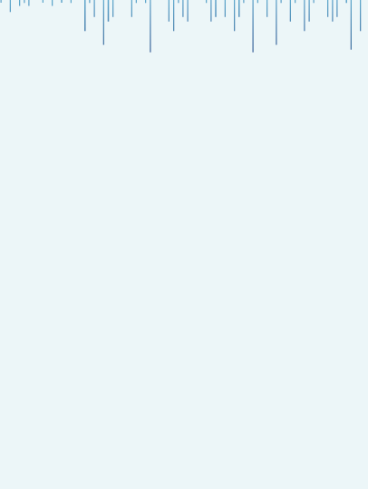



E-commerce Product Delivery Prediction
“In the evolving landscape of online retail, this project focuses on predicting product delivery outcomes using machine learning techniques. By enhancing delivery prediction, we aim to improve operational efficiency and customer satisfaction in the e-commerce sector.”
Presented By : Mahananda M

Slide 3

Agenda
1. Introduction
6. Feature Engineering & Splitting
Context & importance of delivery
prediction.
X & Y split, encoding
2. Objective of the Study
7. Model Selection
Key goals & value of this project
Algorithms used & why
3. Data Collection & Refinement
Pre-processing steps
8. Train-Test Split
Methodology
4. Exploratory Data Analysis (EDA)
9. Model Evaluation & Results
Insights & key patterns
Metrics, comparison

Slide 4


Introduction
E-commerce Delivery is a critical aspect of online retail, directly impacting customer satisfaction and business reputation.
Late deliveries can cause customer complaints, loss of trust, and extra operational costs for businesses.
This project provides a detailed analysis of order and shipping data, specifically focusing on factors that affect whether an order is delivered on time or delayed.
The dataset includes key features such as product cost, discount, shipment mode, customer calls, product weight, and warehouse details.
The target variable, ‘On-Time Delivery’, indicates whether an order is likely to reach the customer within the promised timeframe.

Slide 5
Objective of the Study
✦ Predict delivery status (on time or delayed) ✦ Identify key factors affecting delivery times ✦ Develop a simple predictive model ✦ Deploy results in a user-friendly dashboard ✦ Support better logistics decisions

Slide 6
✦ Raw data loaded and inspected ✦ Removed duplicates ✦ Handled missing values (none found) ✦ Encoded categorical variables (e.g., shipment mode, warehouse block) ✦ Scaled continuous variables where needed
Data Collection & Refinement
Rows - 11000
E-commerce Dataset
Columns -12
0 : Delivery On Time
Target
Variable
1 : Delivery Delayed

Slide 7

Exploratory Data Analysis (EDA)
✦ Understand feature distributions.
✦ Identify outliers and anomalies.
✦ Detect correlations with delivery status.
✦
Both univariate and bivariate analysis were used to better understand individual variables and their relationship with the target (Reached.on.Time_Y.N)

Slide 8
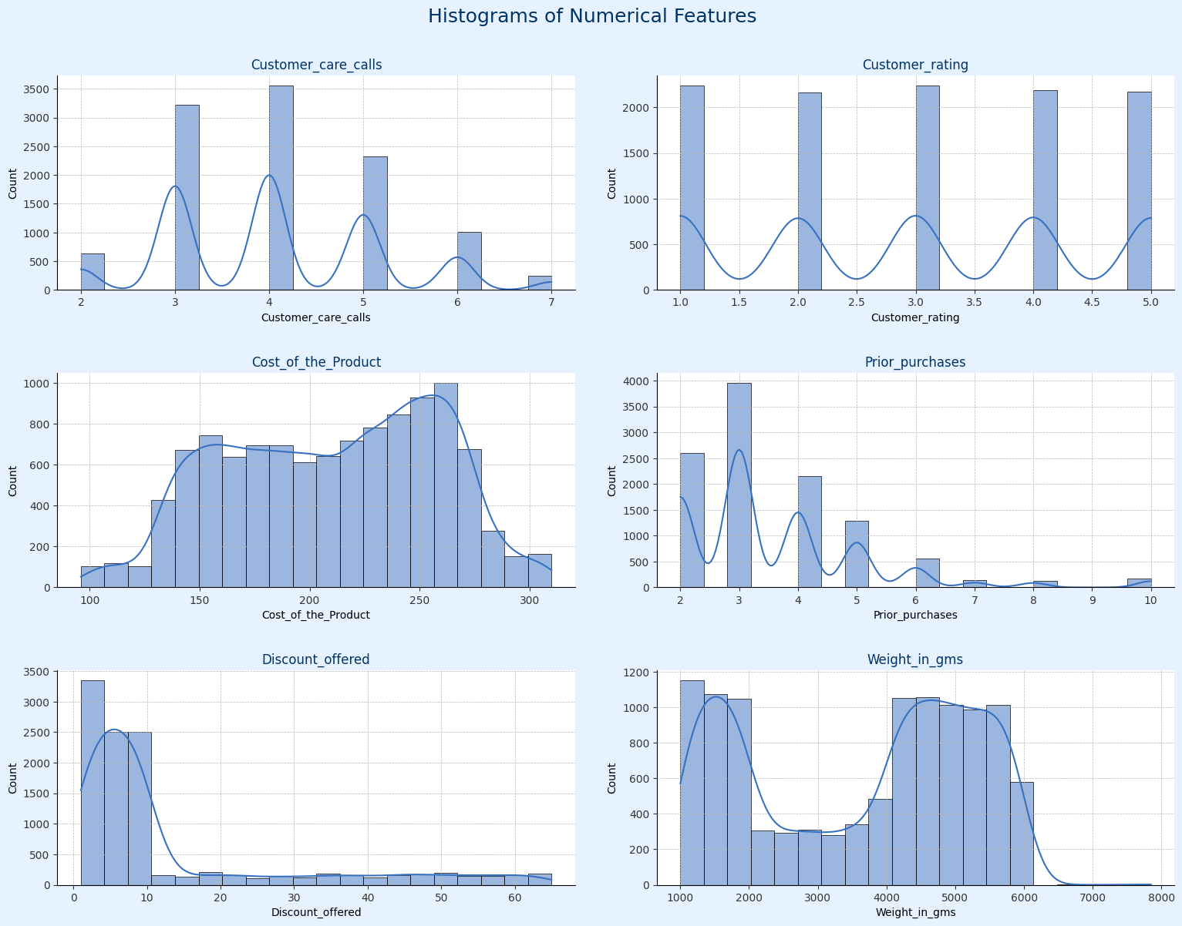
1.Distribution of Continuous Variable
Cost of the Product: Distributed mostly between 100–300 units. Peaks around 200–250, indicating popular price points.
Prior Purchases: Most customers have made 2–5 repeat purchases, showing loyalty and repeat buying behavior.
Discount Offered: Highly right-skewed — majority of discounts are low (0–10%), with very few high-discount cases.
Weight in grams: Bimodal distribution — products cluster around two weight ranges: 1000–2000g and 4000–6000g, showing a mix of light and heavier items.

Slide 9
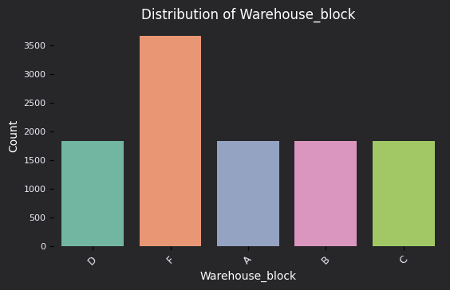
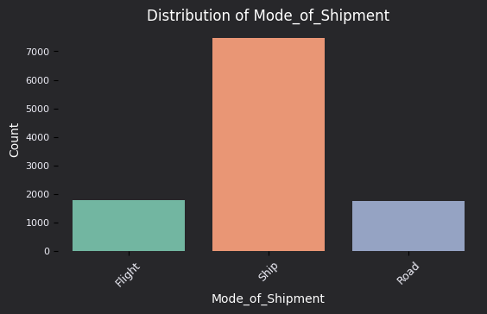
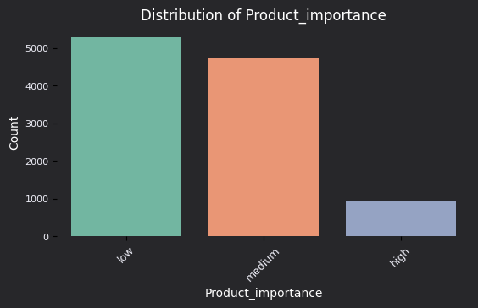
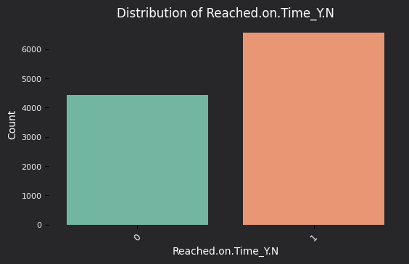
2.Distribution of Categorical Variable
Warehouse Block: The majority of products are stored in Block F, while Blocks A, B, C, and D have similar but smaller shares, indicating uneven distribution of storage capacity.
Mode of Shipment: Ship is the dominant mode of shipment, preferred for most deliveries due to cost-effectiveness. Flight and Road are less common.
Product Importance: Most products are labeled Low or Medium importance, with High importance items making up a small fraction of orders.
Reached on Time (Y/N): The delivery status shows a split — a larger share of orders reached on time, while a notable proportion did not, highlighting potential areas for operational improvement.

Slide 10
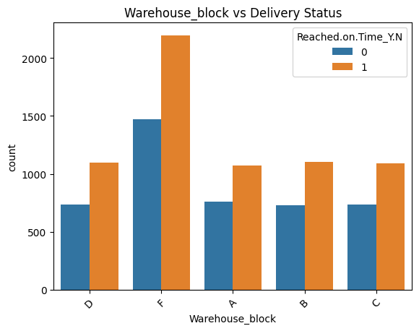
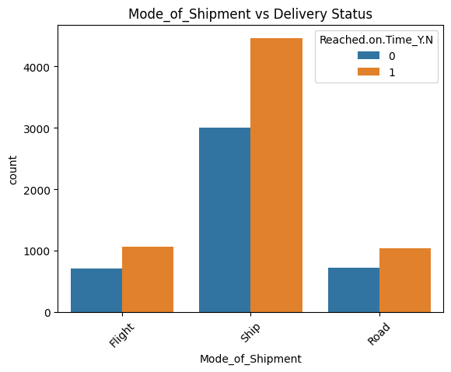
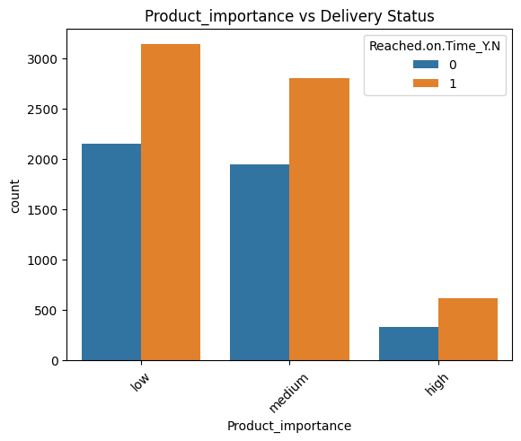
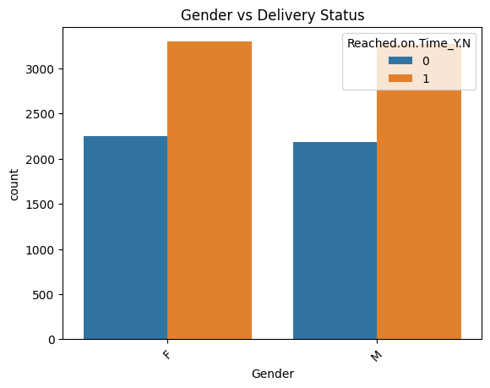
3.Continuous Feature vs TARGET
Warehouse Block: Block F has the highest number of shipments, indicating it handles most of the orders in the warehouse network.
Mode of Shipment: Majority of orders are shipped via Ship, showing preference for economical large-batch shipping. Flight and Road are less common.
Product Importance: Most products are tagged Low or Medium importance, while High importance products are rare.
Gender: Gender does not show significant variation; the dataset is roughly balanced.

Slide 11
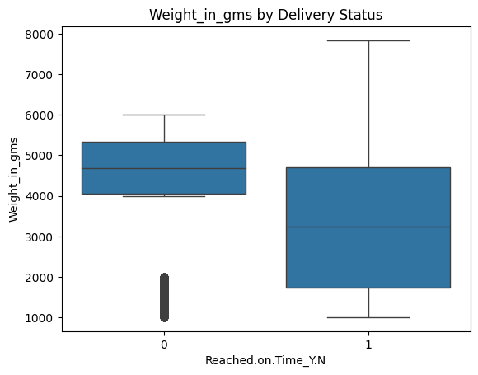
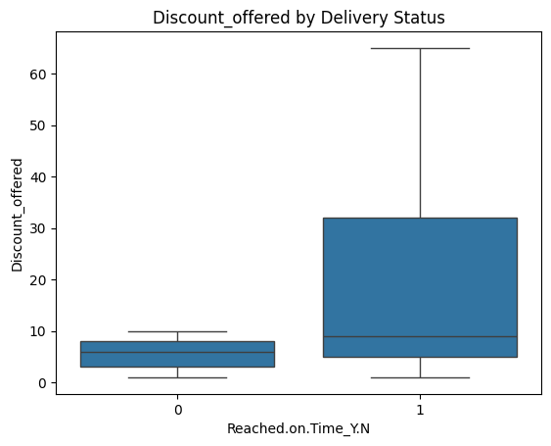
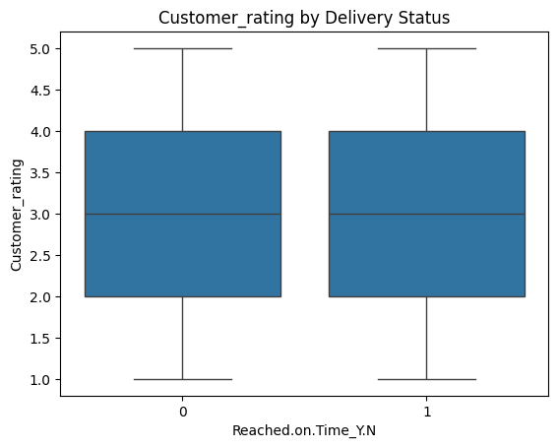
4. Categorical Feature vs TARGET
Weight in Grams:
Higher weight parcels tend to be delivered late more often.
Late deliveries show wider weight variation.
Discount Offered:
Orders with higher discounts are more likely to be late.
Suggests aggressive discounts may affect timely fulfillment.
Customer Rating:
Ratings are evenly distributed for both On-Time and Late deliveries.
This suggests customer feedback (rating) doesn’t significantly influence delivery timeliness.

Slide 12
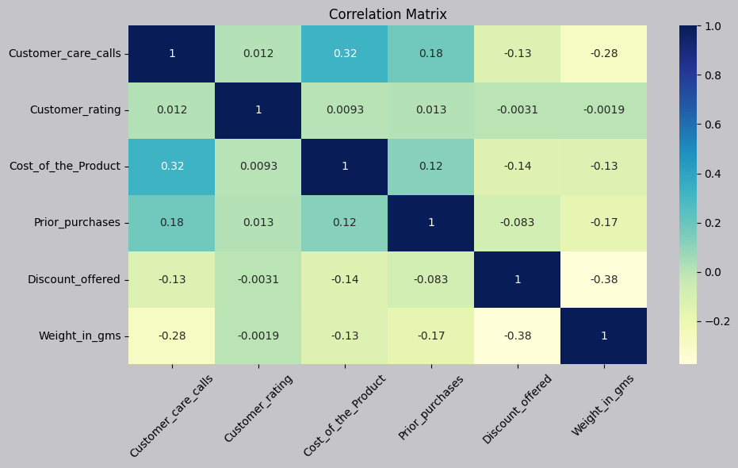
5. Correlation Heat Map
Positive correlation was observed between Customer Care Calls and Cost_of_the_Product, suggesting that more expensive products might trigger slightly more support interactions.
Discount_offered shows a negative correlation with both Weight_in_gms and Cost_of_the_Product, indicating higher discounts are usually applied to lighter or lower-cost products.
Overall, most variables like Customer_rating and Prior_purchases show minimal correlation with other features — this is good as it indicates low multicollinearity.
These relationships ensure that each feature contributes unique information to the prediction model.

Slide 13

Pre-processing and Feature Engineering
Created dummy variables for categorical columns.
Kept all relevant columns due to small dataset
Final feature split:
X: All predictor columns
Y: Delivery Status (1 = Delayed, 0 = On-time)
Outliers Treatment: Checked outliers using IQR method for the continuous features and upon identifying outliers, nature of algorithm, and given small dataset size direct removal of outliers might not be best approach.
Feature scaling was needed for numeric features like Cost of the Product, Discount Offered, and Weight.
Checked scale sensitivity: algorithms like SVM and Logistic Regression benefit from scaling.
Used StandardScaler to make numeric values comparable.
Decision Trees and Random Forests are scale-invariant, so scaling was applied mainly for mixed-model approach.
Scaling was done inside pipelines for smooth integration with training.

Slide 14
TRAIN TEST SPLIT
We split the data into training (80%) and testing (20%) sets.
A fixed random state ensures consistent and repeatable results.
Used stratify=y to maintain the same ratio of on-time and delayed deliveries in both sets.
SPLITTING THE DATA INTO X & Y
The dataset was divided into X and y parts.
"X" represents the independent features like product cost, customer calls, discount, weight, etc.
"y" is the target — whether the delivery is on time or delayed.

Slide 15

Model Selection
Logistic Regression: Used for binary classification (On-Time vs Delayed delivery). Simple and efficient to model the relationship between customer/product features and the probability of delay.
Decision Tree: Chosen for its ability to handle both categorical and numerical features. Easy to interpret and works well to capture decision rules from customer, product, and shipping data.
Random Forest: A robust ensemble method that combines multiple decision trees to improve prediction accuracy. Handles feature importance and reduces over fitting.
Support Vector Machine: Applied for its strength in small-to-medium datasets with complex feature spaces. Helps find the best boundary between on-time and delayed deliveries.

Slide 16
Model Training
Goal: Train a well-generalized model for predicting order delivery status using cross-validation and hyper parameter tuning to ensure reliable and stable performance on unseen data.
1. K-Fold Cross Validation (5-Fold) The training data was divided into 5 equal parts (folds).
Each fold served once as the validation set, while the other 4 folds were used for training.
2. Hyper parameter Tuning Tested different combinations of model settings
Tuned:
Number of trees
Tree depth
Minimum samples for splits and leaves
Used GridSearchCV to find the best combination
Picked the parameters with the best validation score

Slide 17
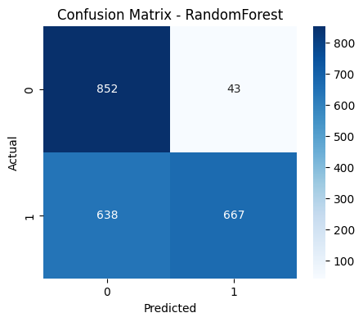
Evaluation of model
Accuracy
Precision
Recall
F1-Score
Understanding
🔹 Precision: Measures how many of the predicted positive cases are actually positive (how correct the positive predictions are).
🔹 Recall: Measures how well the model finds all actual positive cases in the data (how well it catches true positives).
🔹 F1 Score: Combines precision and recall into one balanced score, helpful when you want to balance false positives and false negatives.
Random Forest Tree | 66% | 68% | 66% | 67%
Logistic Regression | 63% | 63% | 63% | 63%
Decision Tree | 64% | 64% | 64% | 64%
KNN | 65% | 65% | 65% | 65%
Confusion Matrix
Model Comparison
True Positives (Delayed & Correct): 669
True Negatives (On Time & Correct): 853
False Positives (Predicted Delayed, Actually On Time): 42
False Negatives (Predicted On Time, Actually Delayed): 636
Random Forest Performance: The Random Forest model achieved 66% accuracy, with balanced precision (68%) and recall (66%), showing it is the best performing model for predicting purchase intent in this E-commerce dataset.

Slide 18

Conclusion
Key Finding
The Random Forest and Decision Tree models achieved similar accuracies around 66%–68%, showing moderate predictive performance on the current dataset.
Limitations
The dataset lacks timestamps, session durations, and detailed user journey data, which limits the model’s ability to capture time-based patterns.

Slide 19
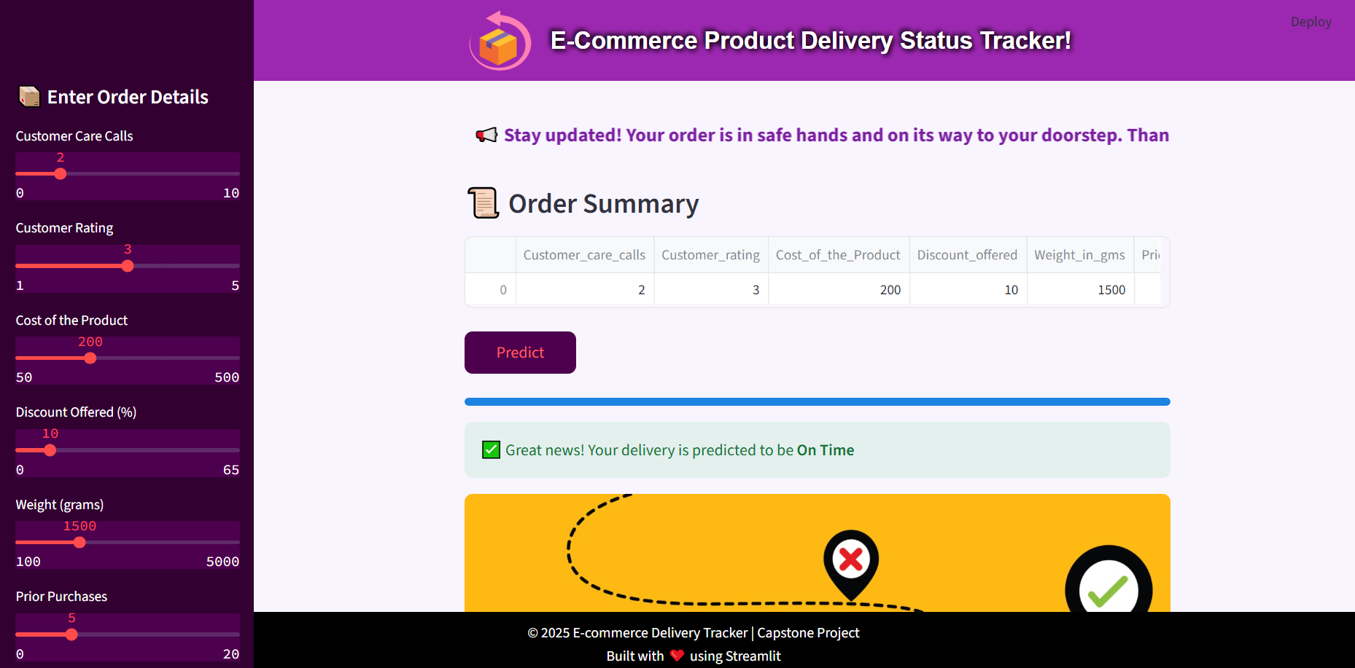

Deployment: Streamlit App

Slide 20
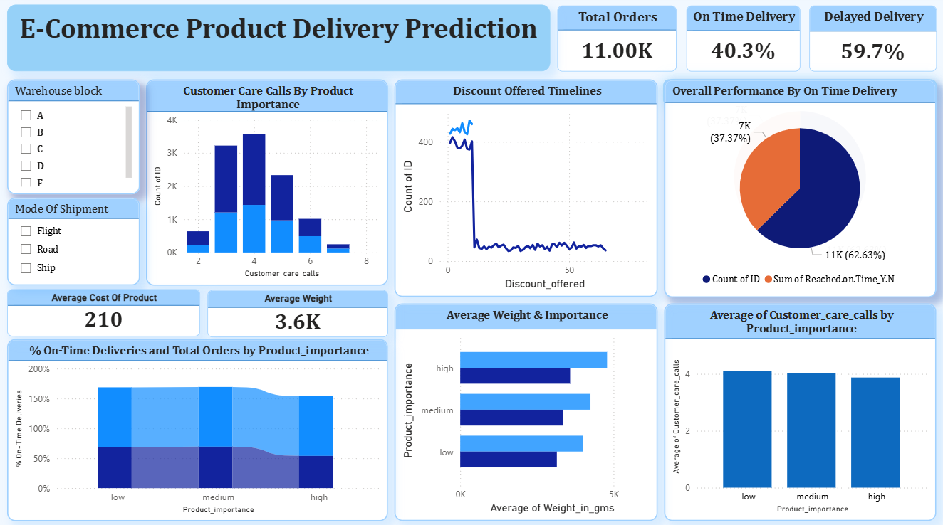
Power BI Dashboard

Slide 21
Thank You!

